Slide 1
Function Overloading
Two or more functions having same name but different argument(s) are known as overloaded functions.
In C++ programming, two functions can have same name if number and/or type of arguments passed are different.
These functions having different number or type (or both) of parameters are known as overloaded functions. For example:
int test() { }
int test(int a) { }
float test(double a) { }
int test(int a, double b) { }

Slide 2
Function Overloading
The number and type of arguments passed to these two functions are same even though the return type is different. Hence, the compiler will throw error.
int test(int a) { }
double test(int b){ }

Slide 3
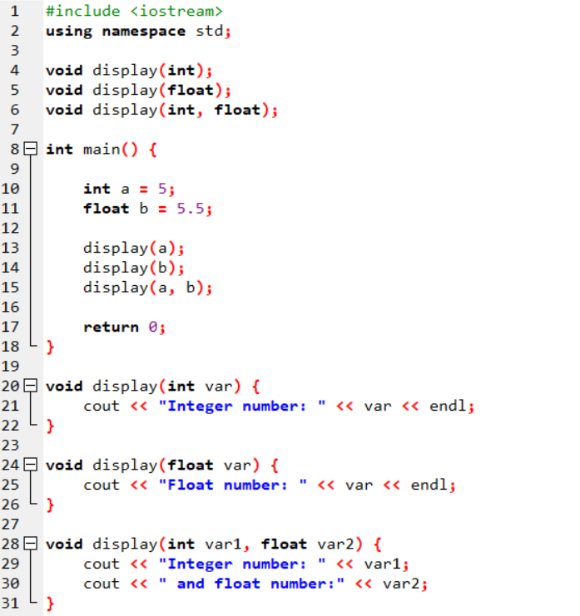

Slide 4
Pointer Variable Declarations and Initialization
Why we need Pointers:
Pointes enable programs to create dynamic memory, which can grow at runtime using.
The main difference between normal variables and pointers is that, variables contain a value, while pointers contain a memory address.
Memory address:
We know each memory address contain some value.
Thus if pointers contain memory addresses, we can get its value (indirectly).
C
…
7
3
4
…
C is a variable
172
173
174
175
176
177
178
179
180
181
Memory
P
P is a Pointer ?
…
174
3
4
…
832
833
834
835
836
837
838
839
840
841

Slide 5
Pointers
A pointer variable must be declared before it can be used.
Examples of pointer declarations:
int *a;
float *b;
char *c;
The asterisk, when used as above in the declaration, tells the compiler that the variable is to be a pointer, and the type of data (the value that we get indirectly) that the pointer points to.

Slide 6
Referencing
int C;
int *P; /* Declare P as a pointer to int */
C = 7;
P = &C;
C
…
7
3
4
…
172
173
174
175
176
177
178
179
180
181
P
…
174
3
4
…
832
833
834
835
836
837
838
839
840
841

Slide 7
Dereferencing
The unary operator * is the dereferencing operator
Applied on pointers
Access the value of object the pointer points to
The statement
*P = 5;
puts in C (the variable pointed by P) the value 5

Slide 8
Pointers & Allocation
Pointing to something that already exists:
int *ptr, var1, var2;
var1 = 5;
ptr = &var1;
var2 = *ptr;
var1 and var2 have room implicitly allocated for them.
?
?
?
5
5
ptr
var1
var2

Slide 9
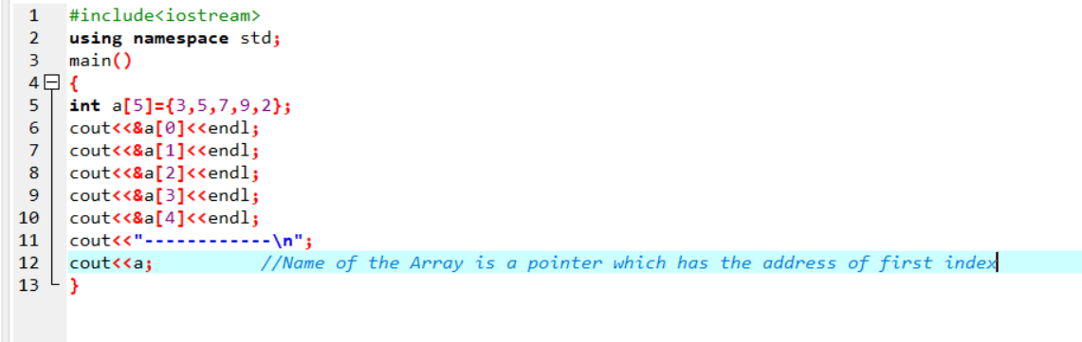

Slide 10
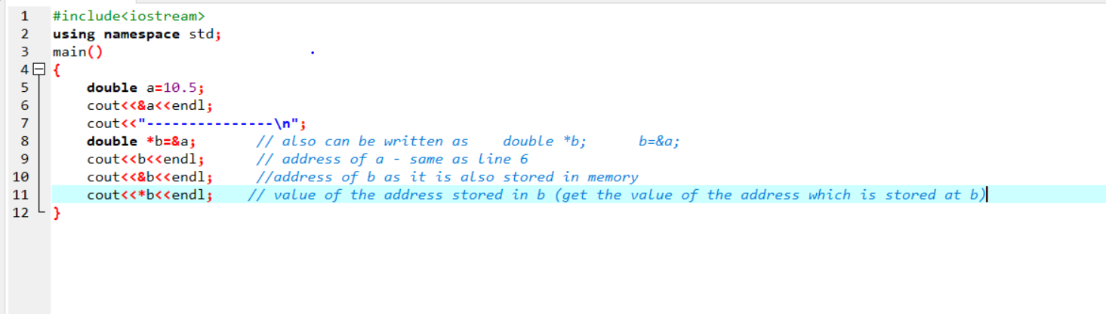
The Ampersand (&) and Asterisk (*) Sign

Slide 11
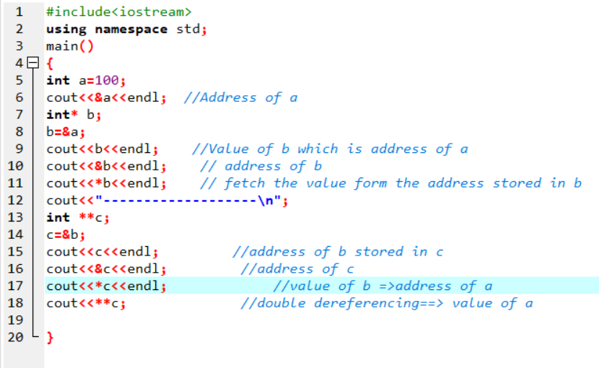

Slide 12
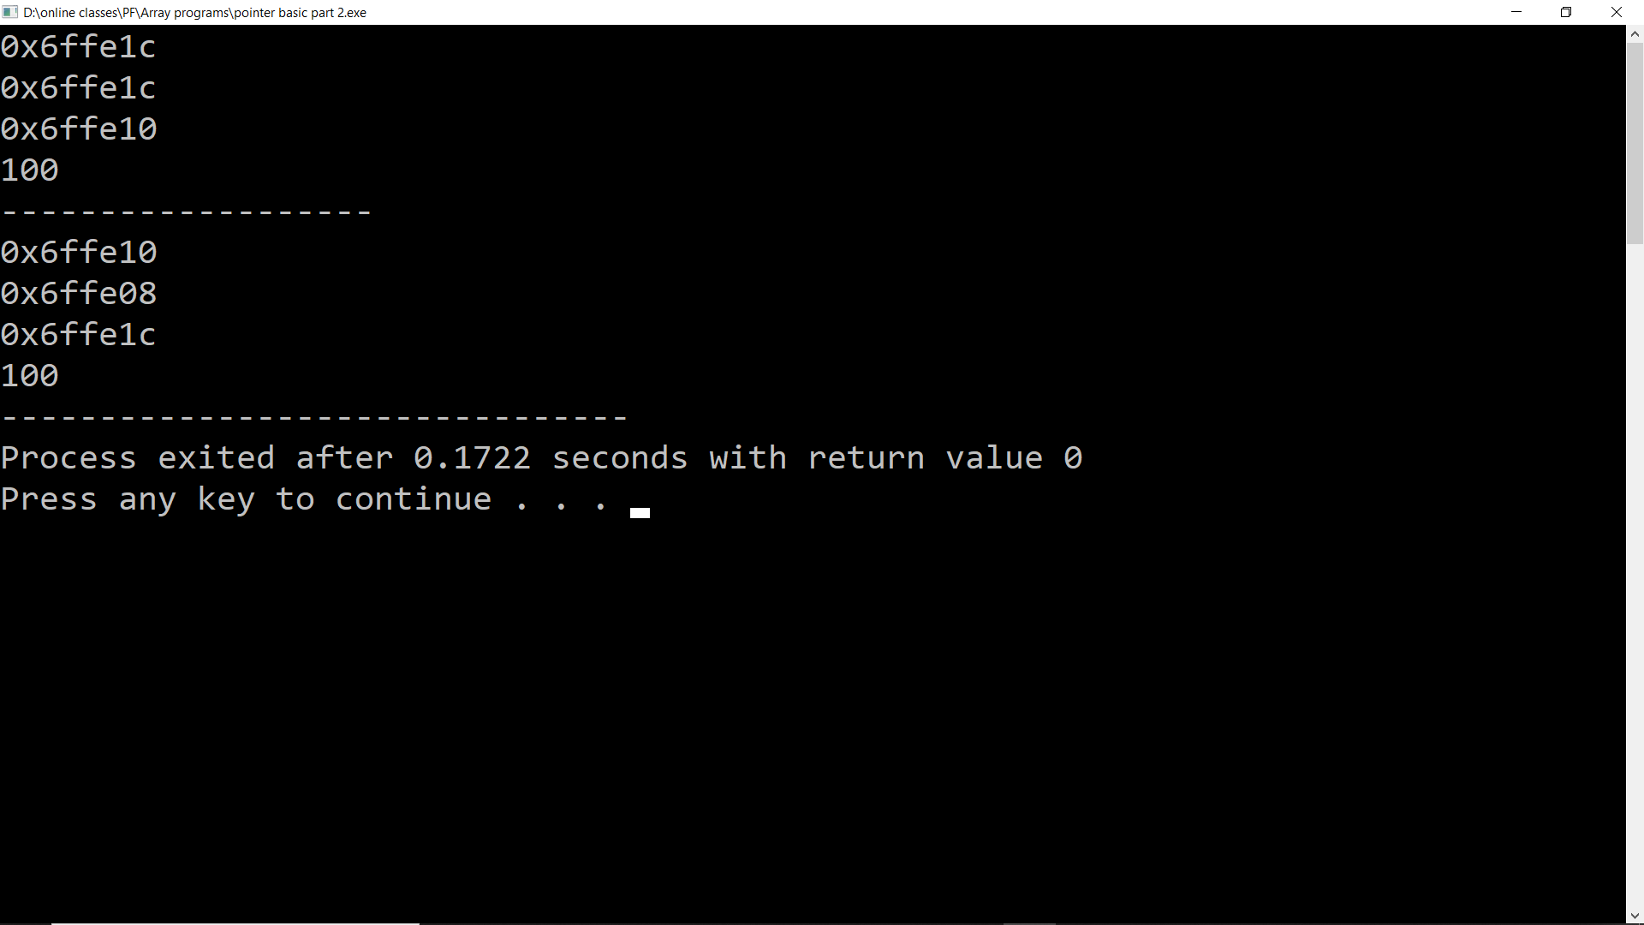

Slide 13
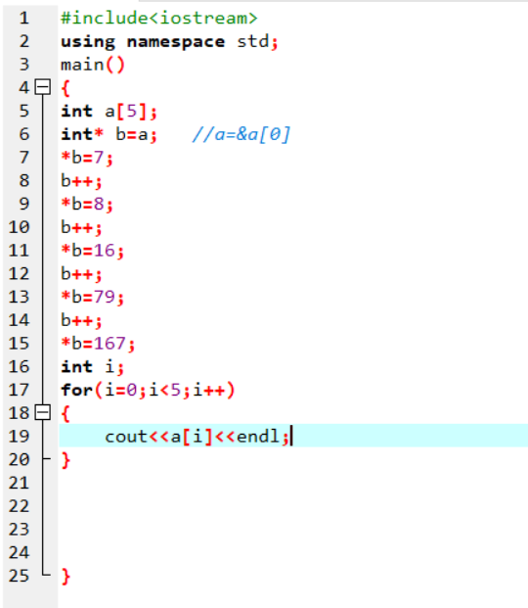

Slide 14
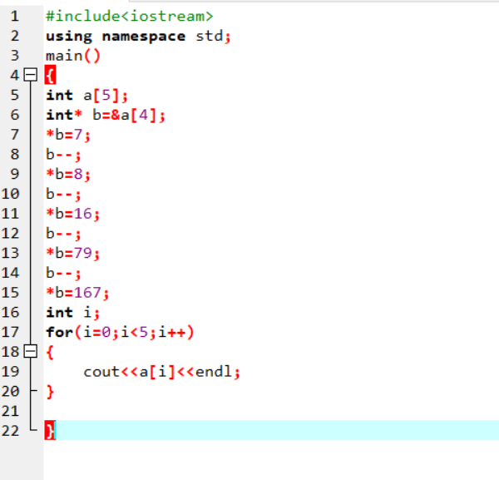

Slide 15
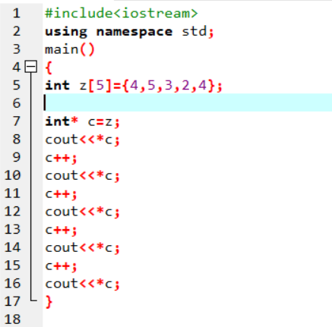

Slide 16
